Slide 1
Estimating Ethereum Gas Prices
Brandon Butler
DSI Capstone October 2017

Slide 2

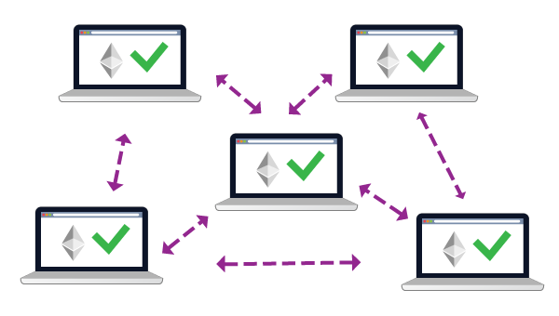
Notes:
- Ethereum is the next generation of blockchain technology, the first implementation being bitcoin
smart contract: A smart contract is a computerized transaction protocol that executes the terms of a contrat https://urbancrypto.com/ethereum-blockchain/
add a little more on what blockchain is

Slide 3
Ethereum gas
Computational effort required to process transaction
Gas price:
A set price to pay per unit of gas spent
Total Fee = Gas Price X Gas Used
– Set gas price too low
– Set gas price too high
Transaction fails
Overpaid

Slide 4
Collect data from Ethereum API
Transaction level
Block level
Engineer features based on hindsight
Gas price recommendation

Slide 5
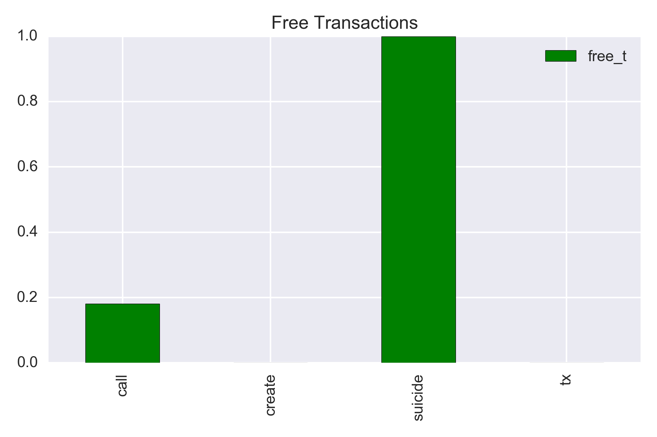
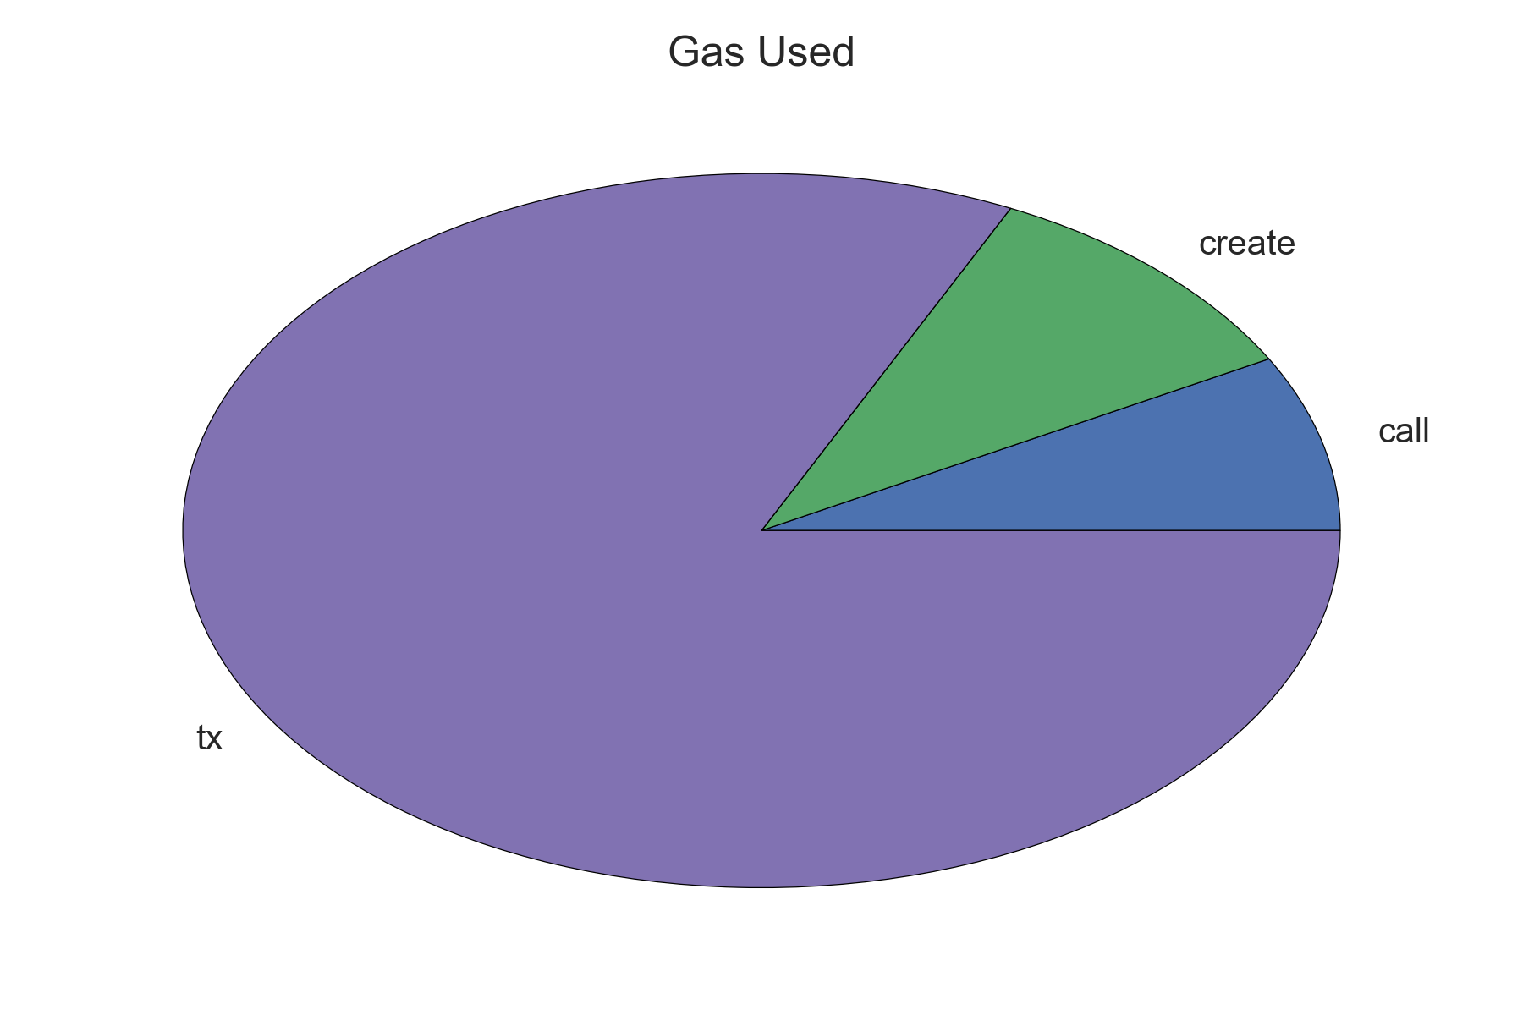
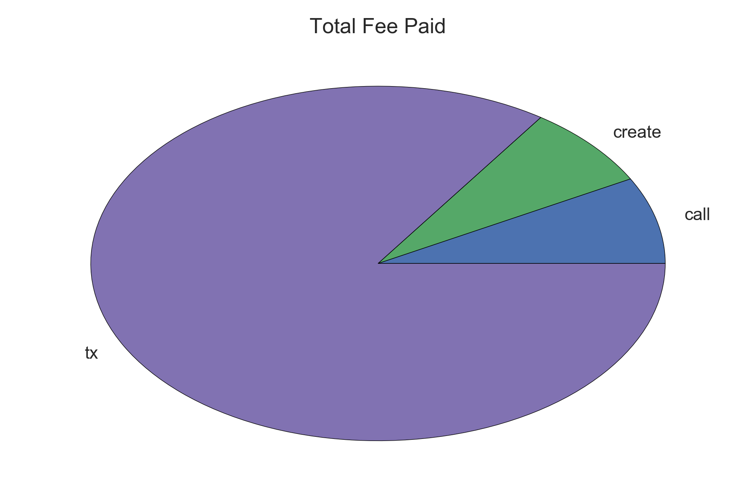
Notes:
- make less confusing

Slide 6
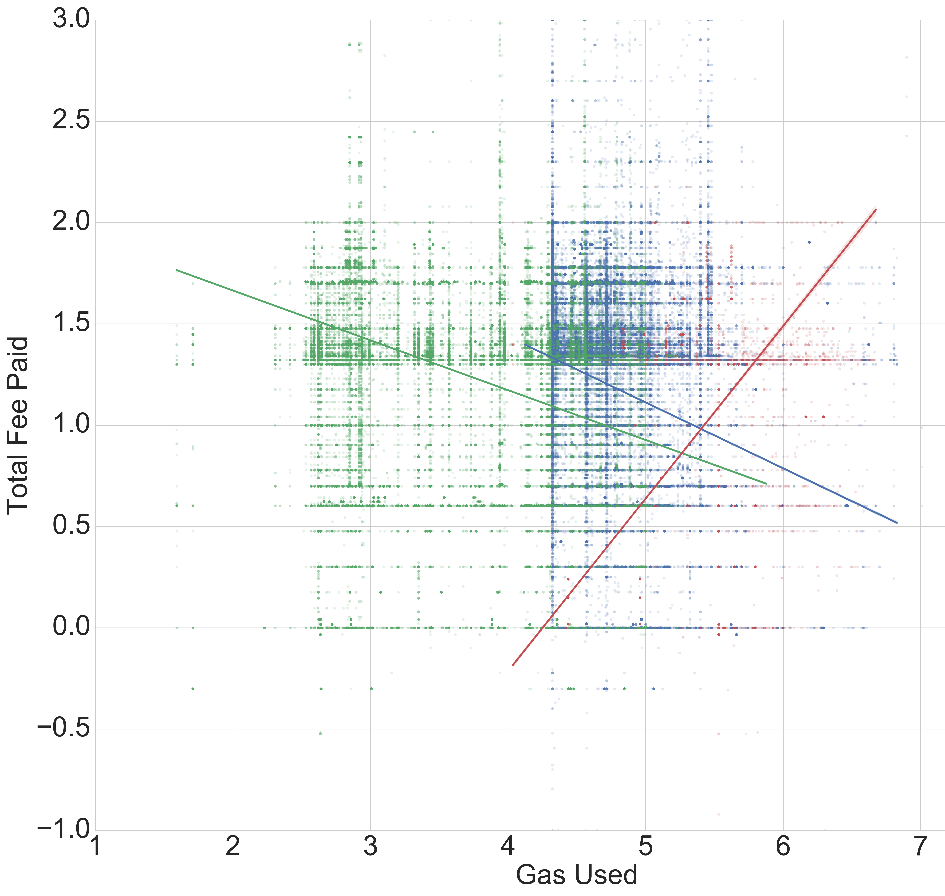
Notes:
- make labels

Slide 7
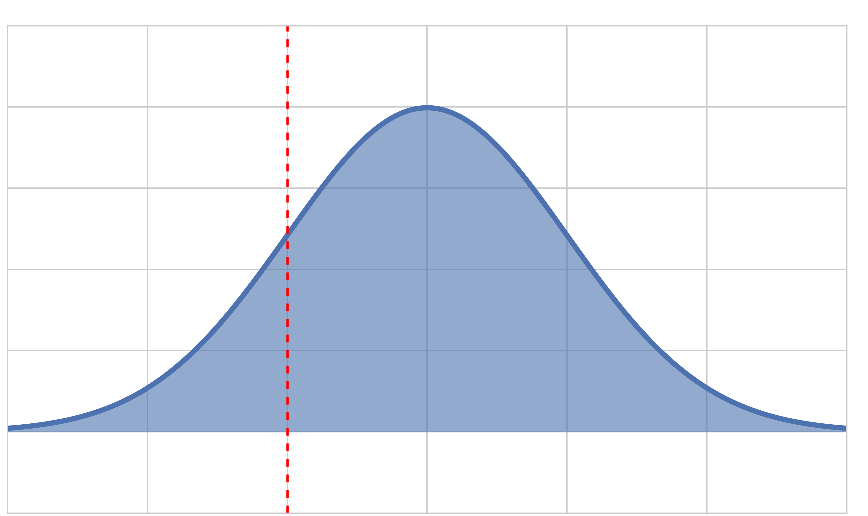
Label design
Estimated price with hindsight
Given information about previous blocks in time, what is our estimate of what the price should be
Q1
“Miner Value”
Incentive to accept transaction
μ
Notes:
- “Miner Value”: Fraction paid per block / Fraction gas as per block
- take out equestion or define everythin

Slide 8
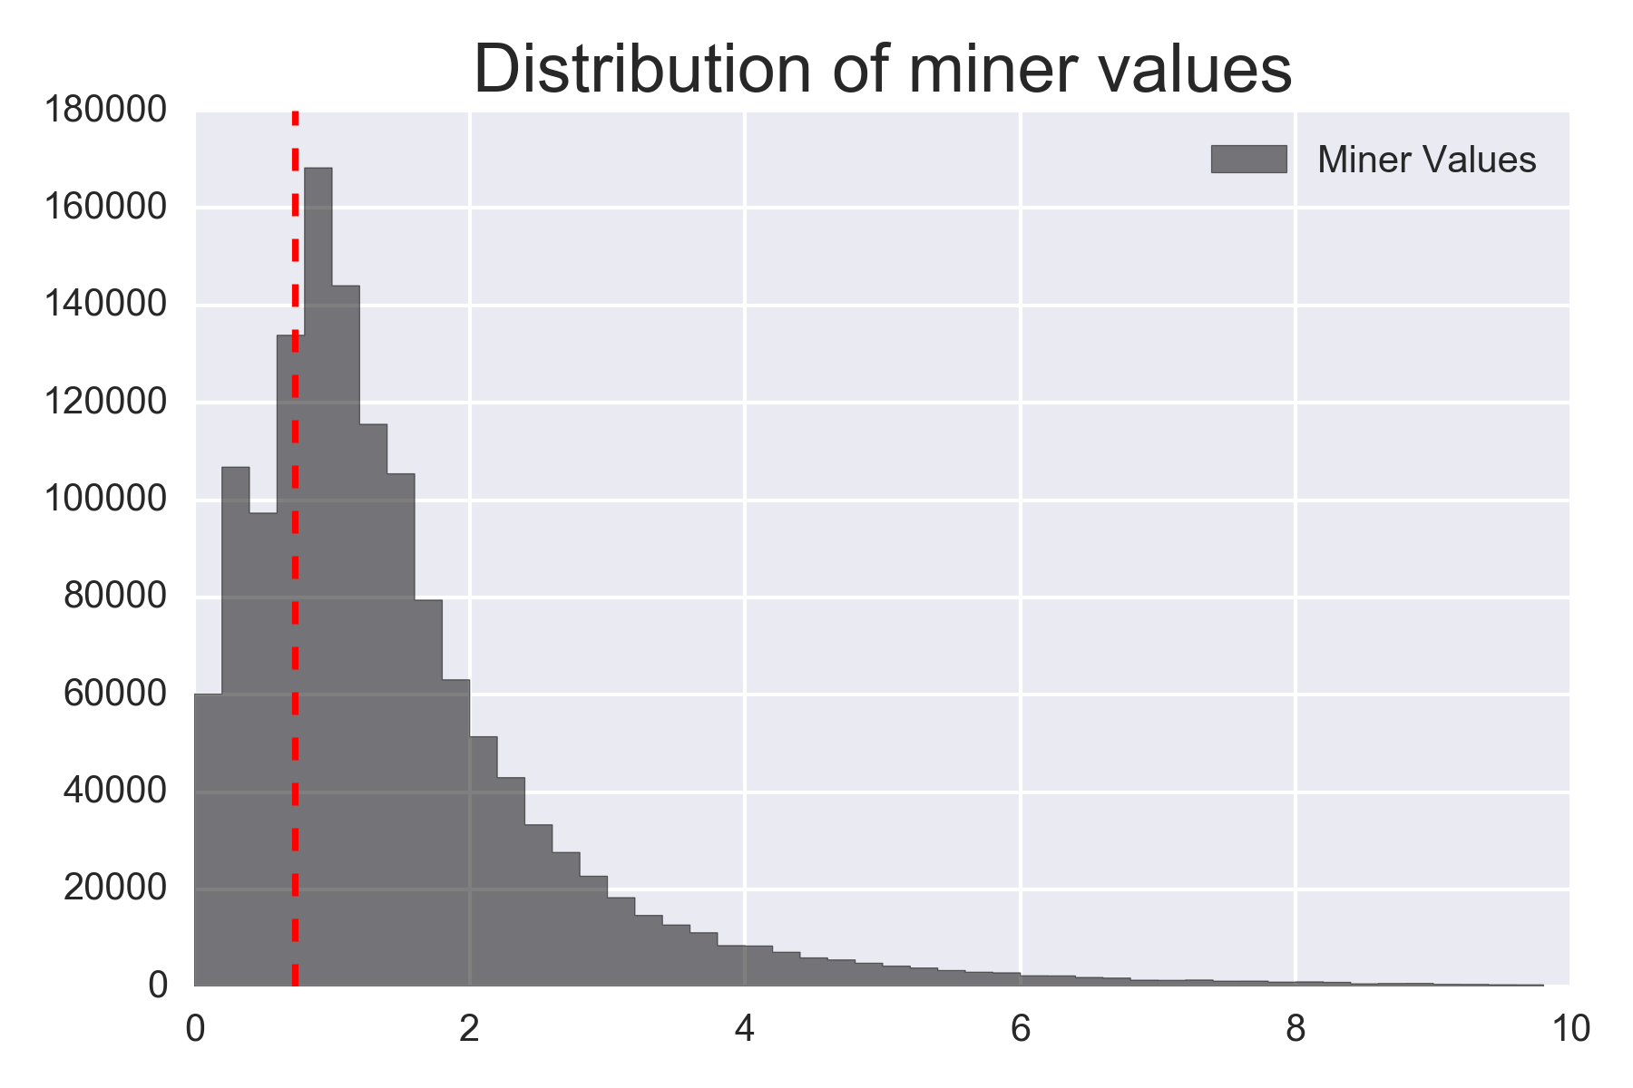
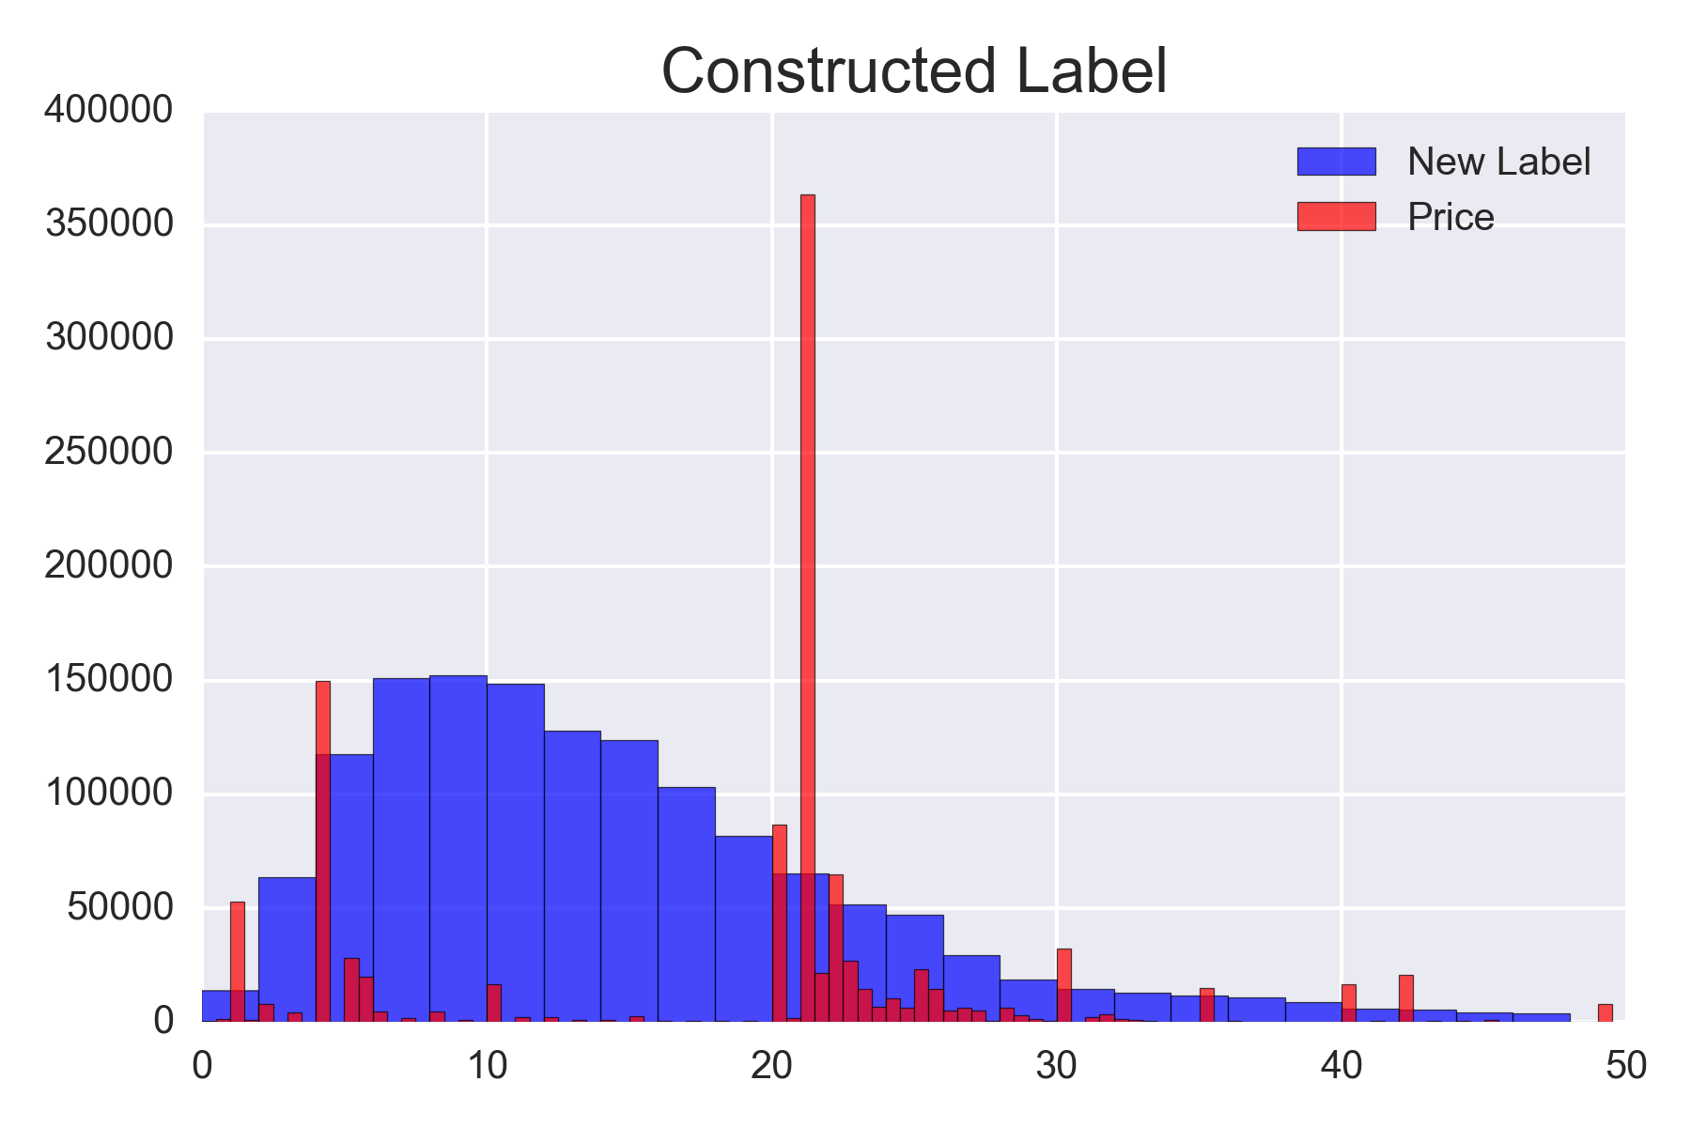
μ = Q1

Slide 9
Feature engineering
Hindsight features: average values over two time horizons
– 6 previous blocks (~ 1min): current state
– 60 previous blocks (~10min): long-term view
6 block window
60 block window
Block time
Price
Gas used
Tx count
Difficulty
Block time
Price
Gas used
Tx count
Difficulty

Slide 10
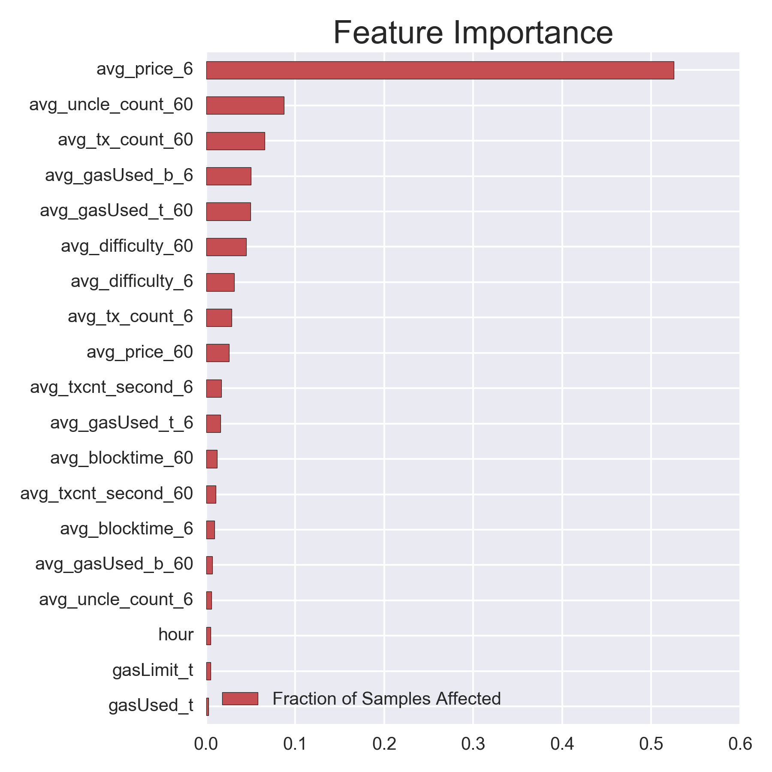

Slide 11



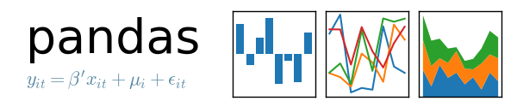

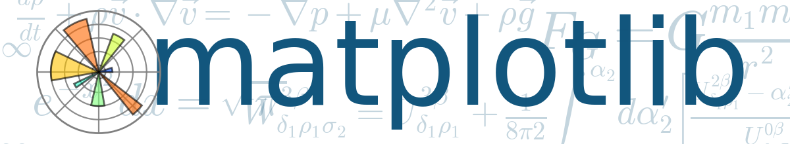

Slide 12
Future
– Utilize entire ethereum blockchain data while also taking in real-time data as it comes in
– Neural network model
– Provide real-time gas recommendations

